Slide 1



Sharing Lessons from Integrity Pact Experience
– challenges, best practices, room for improvement –
Integrity Pact Stakeholder Event
14 December 2017 - Bucharest, Romania
funded by the

Slide 2
Hungarian specificities in implementing Integrity Pacts
  - IP in the form of one trilateral contract;
  - joining of tenderers: mandatory or voluntary?
  - financing: contracting authority (CA), owner of CA (f.e. local government in case of a municipality-owned company), donor

Slide 3
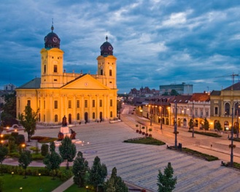
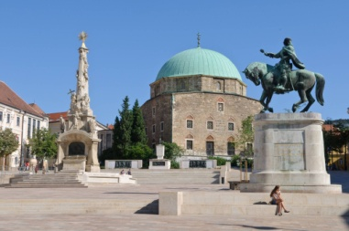
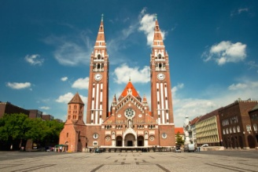

The beginnings of Integrity Pact Projects in Hungary
2009. „road show” – presentations, interactive games in major Hungarian cities
  international experiences;
  articulating doubts <—>
  advantages
2010. the first integrity pacts with
Central Bank of Hungary on
procuring taxi services

Slide 4
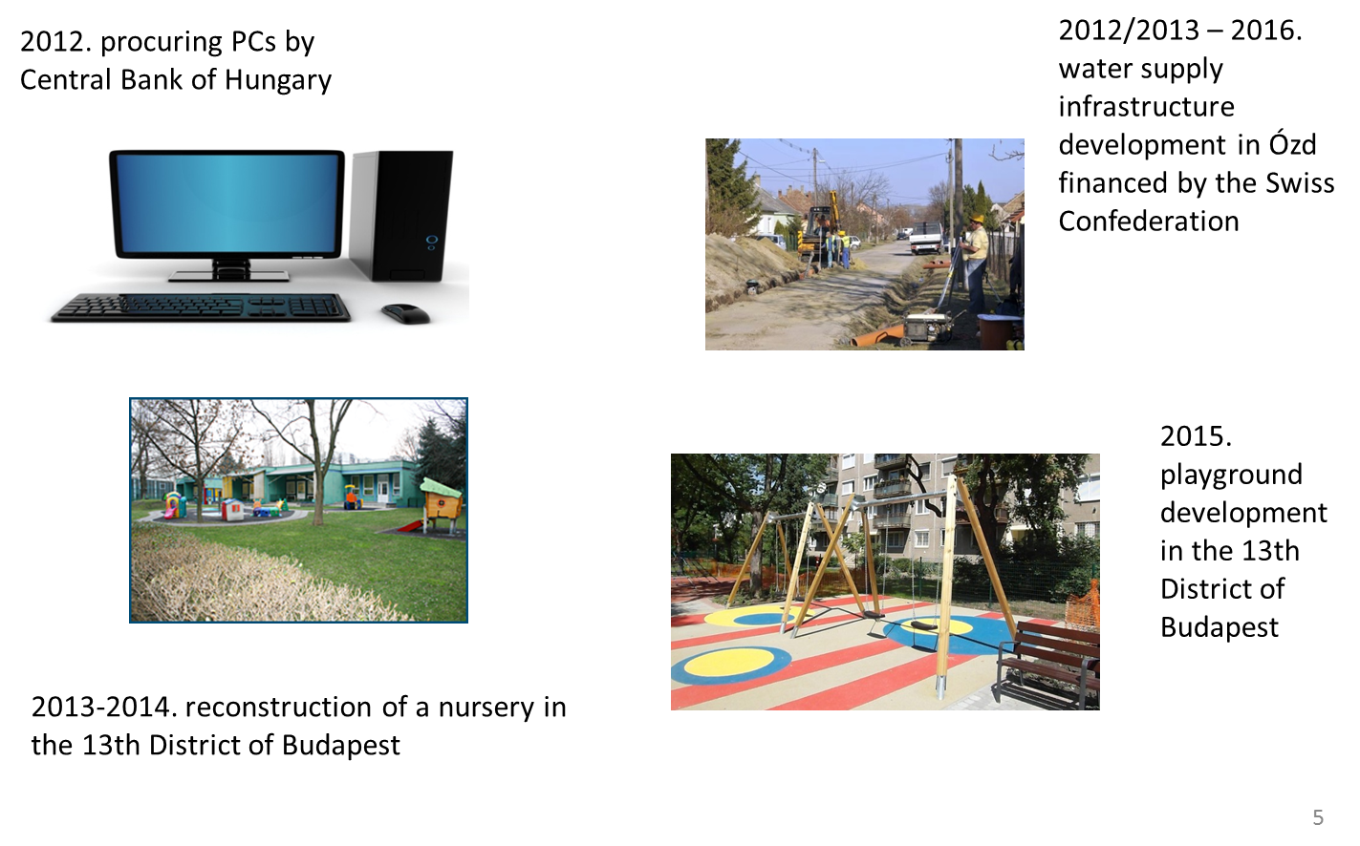
TI Hungary’s Previous Experiences

Slide 5
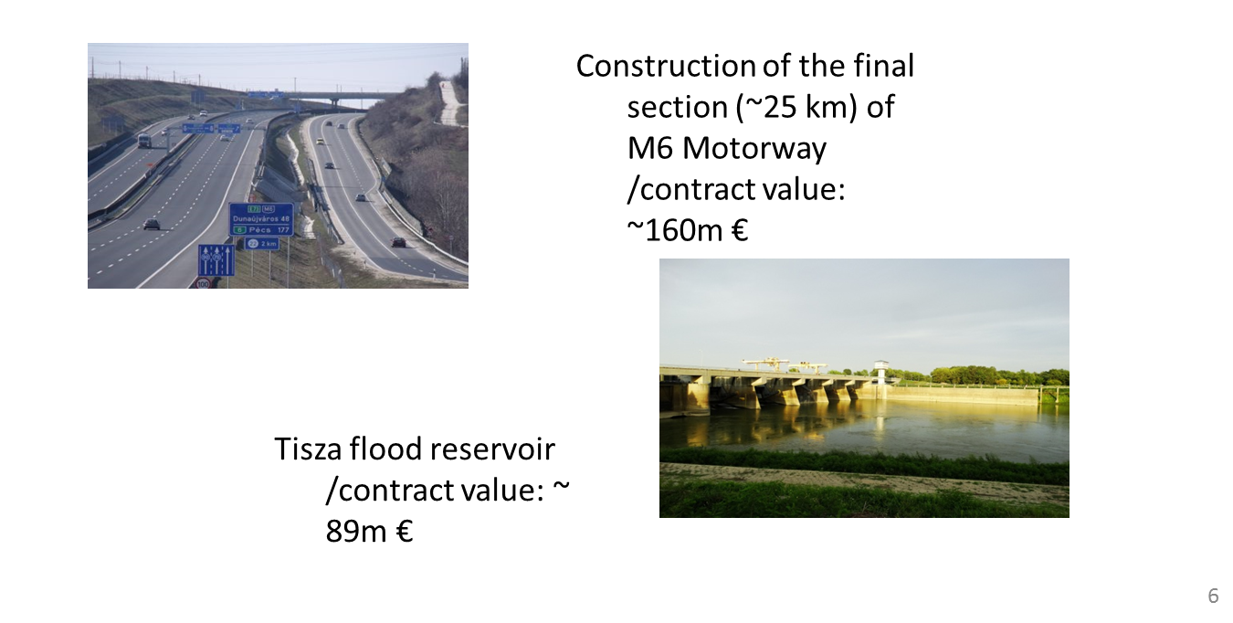
IPs to be implemented within the framework of the European Commission’ pilot project

Slide 6
Lessons from Hungarian experience with IP
  prices were lower by 30%;
  increased trust from companies toward the public institutions;
  increased competition;
  authorities, State-owned companies: good PR value, PR possibility;
  building trust and good cooperation with monitor, good experiences => usually more IPs later

Slide 7
Bulgarian specificities in implementing Integrity Pacts
  IP in the form of one trilateral contract
  Independent financing of the monitoring
  IP voluntary for bidders
  Incentive for accession to the IP – a White List and dissemination of its information.

Slide 8
TI Bulgaria’s Previous Experiences
  2000: Independent monitoring of the privatization of the National Telecommunication Company - no IP
  2005: Independent monitoring of the construction of Trakia Highway - IP signed by the CA
  2010: Independent monitoring of tender procedures of the Ministry of Health, Ministry of Labor and Social policy and the Road Infrastructure monitoring – IPs signed by both CAs and successful contractors

Slide 9
IP to be implemented within the framework of the European Commission’ pilot project
  DESIGN AND BUILD OF STRUMA MOTORWAY LOT 3.1 ZHELEZNITSA TUNNEL
  /conract value ~ 128 MEUR/

Slide 10
Challenges
  Financing;
  Participation of the Contracting Authority: voluntary or mandatory?
  Who is the monitor?
  Need for specialised external experts

Slide 11
What worked well so far?
  Financing: donor or other external finances provides independecy;
  Participation of the Contracting Authority: voluntary – better cooperation, higher level of trust
  Who is the monitor: in Hungary, TI as a monitor worked well;
  Need for specialised external experts: open tender, important to have some personal commitment to the cause;
  White list.

Slide 12
Room for Improvement
  Participation of the Contracting Authority: mandatory – active buy in from Contracting Authority.
  Who is the monitor: in Hungary, serious challanges with other organisations;
  Need for specialised external experts;

Slide 13
  Thank you for your attention
  Michaela Rajkova Gabriella Nagy
  Project manager head of public funds programs
  Transparency International Bulgaria Transparency International Hungary
  mihaela@transparency.bg gabriella.nagy@transparency.hu
  http://integrity.transparency.bg http://transparency.hu/
funded by the

