Slide 1
Good Governance in Norway Seen from the Grassroots
Harald Koht
Oslo and Akershus University College
Professor, Ph.D
Norwegian Neighborhood Federation
Chairman 1997-1999 and 2010
27 November 2014
Bucuresti

Slide 2
A prescriptive definition
Good, effective public governance helps to strengthen democracy and human rights, promote economic prosperity and social cohesion, reduce poverty, enhance environmental protection and the sustainable use of natural resources, and deepen confidence in government and public administration.
OECD 2008

Slide 3
Governance and civil society
The idea of “Good Governance” provides for the opening of a broader debate about the role of voluntary organizations in politics, including the rise of networks that allow for decision-making by negotiation.

Slide 4
Two types of people’s organizations
Traditional
Active membership with own practical and social activities
Elected leadership
Accountability to general meetings of members
Campaign organizations
Action groups
Self-appointed leadership and no fixed membership

Slide 5
Norwegian neighbourhood clubs - 1
Traditional membership organizations
Democratic, elected leadership
Based on territorial principles: Anyone living within a defined area can become a member
No national authority that defines goals and duties

Slide 6
Norwegian neighbourhood clubs - 2
Early founding years: 1870-1880s
Rapid growth: From 4 000 (1982) to 8 000 (2012)
Strong in suburban and recently urbanized areas with owner-occupied housing
Includes both men and women
A huge variety of activities

Slide 7
Typical activities
 | Percentages
Outdoor maintaince and tidying | 87
Playgrounds | 64
Commons care | 24
Street lights | 23
Ball parks (handball etc.) | 15
Christmas | 55
Community party | 45

Slide 8
What’s the point of raking leaves?
Here were citizens reaffirming a small measure of control of their shared physical surroundings, and demonstrating a sense of community, which is part of what cities are about – or should be.
Witold Rybczynski, City Life: Urban Expectations in a New World , New York 1995

Slide 9
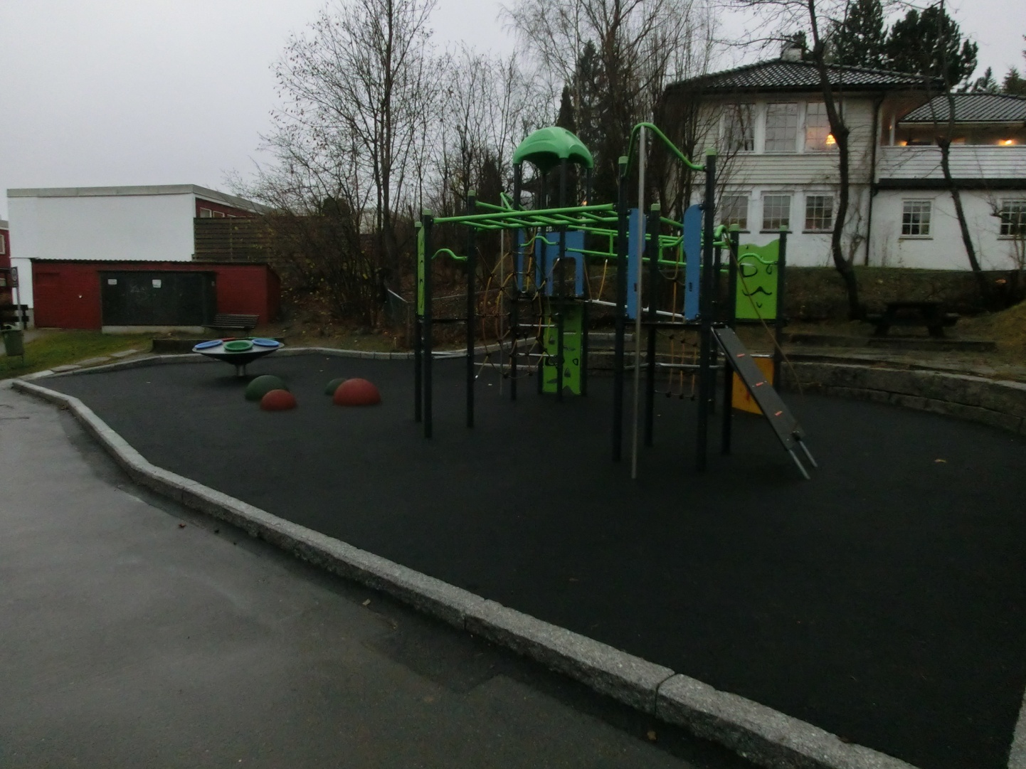
New playground in Oslo

Slide 10
Cooperation with the municipality: one-way or two-way partnerships?
Area of cooperation | Relationship | Percentages
Playgrounds | Cooperation | 63
Outdoor tidying and cleaning | Cooperation | 60
Trafic safety | Lobbying | 58
Planning | Deliberation | 29
Cultural activities | Coproduction | 23
Community meeting house | Subsidies | 15
Activities for the elderly | Cooperation, subsidies | 8

Slide 11
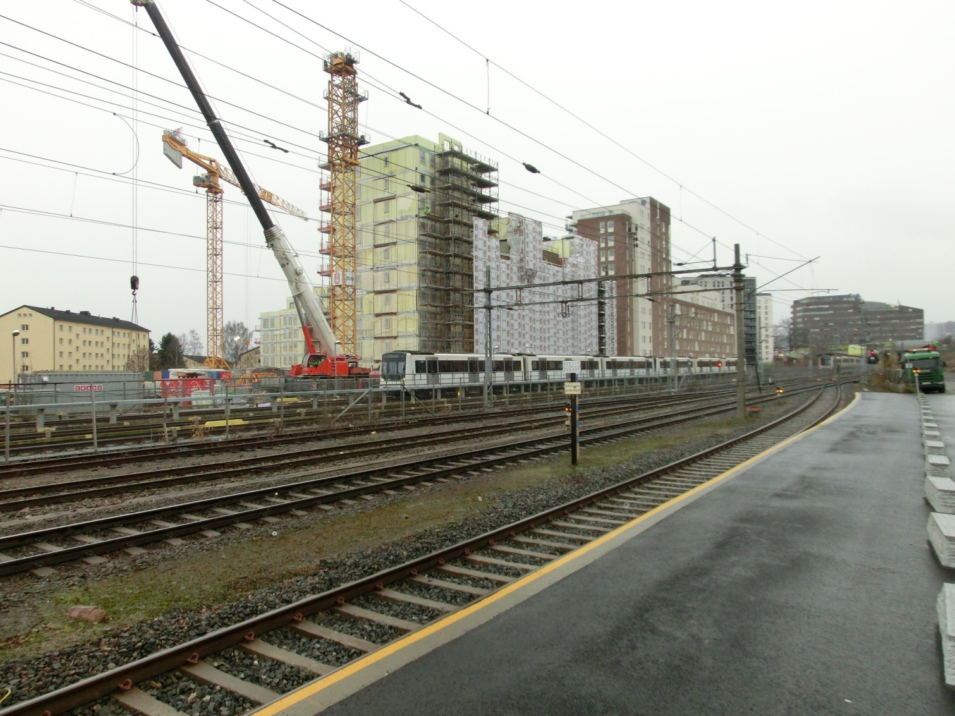
New housing by metro and railway

Slide 12
How to communicate – part 1
Traditional | Percentages
Written hearings | 62
Oral hearings (meetings) | 43
Deputations | 4

Slide 13
How to communicate – part 2
Modern – deliberate | Percentages
”The open half hour” | 12
Local committees | 11
Conferences | 9
Committee membership | 8
Electronic networks | 7
User committees | 4
Interviews | 4
Participation in budgeting | 2

Slide 14
Satisfaction with the partnership with local government
 | 1991 | 2013
Very high | 17 | 13
Satisfactory | 61 | 48
Poor | 15 | 27
Non-existent | 4 | 12
No answer | 3 | 0

Slide 15
The future
The future of the cities, whatever form it takes, will depend on the goodwill of its citizens for its well-being.
Witold Rybczynski, City Life: Urban Expectations in a New World , New York 1995

Slide 16
How for citizens to win influence?
Co-production
Publicity
Timeliness
Incrementalism: One small step at a time

Slide 17
Challenges
Know the steps in decision-making: Always too late?
Gaining transparency
Speaking the language of decision makers

Slide 18
Thank you
for your attention

